Slide 1
Database Management
Systems
Term Project Presentation
Integrated Database for Restaurants
Yeongwoong Choi
December 5, 2023

Slide 2
Overview
Entities, Relationships & Types
E-R Diagram
SQL Queries
Demo Program
Specification
Tables
Part 1
Part 2
Part 3
Part 4

Slide 3
1
Specification

Slide 4
Specification
Entities
Entities can be derived from the specification.
Relationships
Relationships can also be obtained from the specification.

Slide 5
Entities
Dish
Dishes are stored with their identifiers, which should be unique, name of them, prices of them.
Restaurant
A restaurant has its identifier, which is unique and relates only with itself, types of food that it serves, location of it, phone number, and rating which has been given by customers. It is assumed that the rating is on a scale of 0 to 5 and the restaurant can only have one phone number.

Slide 6
Entities
Owner
An owner has a resident registration number, which is unique - subtly different from a social security number, his/her name, and the phone number.
Broadcast
A broadcast has a unique name and the name of the broadcasting company.
Customer
A customer has his/her identifier, name, sex, phone numbers, points, and his/her preference for the types of dishes. Phone numbers can be more than one.

Slide 7
Entities
Vendor
A vendor has a unique vendor code, name of it, types of products that it has, the price of the ingredients.
Dish Style
Each type of certain dish has a discrete name and its description.

Slide 8
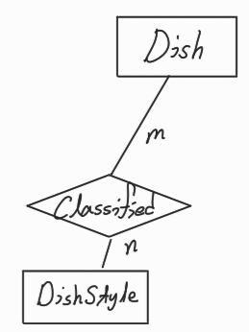
Relationships
From the specification
A dish can possess a variety of types such as Korean, Chinese, and Mexican. Types can also belong to many dishes.
Classified
A dish can be classified as multiple dish styles.
Many-to-Many

Slide 9
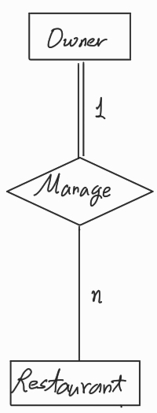
Relationships
From the specification
The number of owners of one restaurant should be 1. An owner may have and manage several restaurants, but he/she must manage at least one restaurant.
Manage
An owner can manage more than one restaurant.
1-to-Many

Slide 10
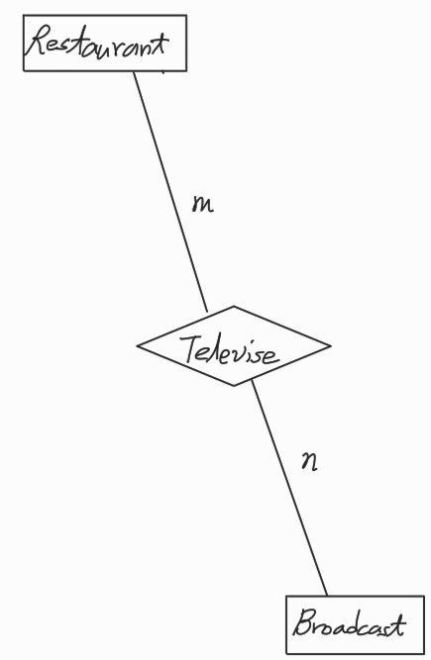
Relationships
From the specification
If it was televised, the date is stored. It can appear on multiple TV shows, and they can show various restaurants.
Televise
Many broadcasts can televise many restaurants.
Many-to-Many

Slide 11
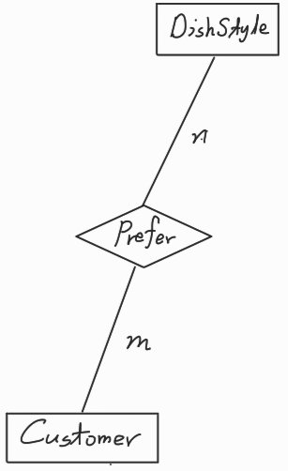
Relationships
From the specification
A customer can have his/her preference for the types of dishes.
Prefer
Many customers can prefer many types of dishes.
Many-to-Many

Slide 12
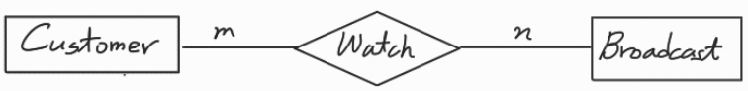
Relationships
From the specification
A customer can watch many TV shows. One TV show may be able to be seen by many people.
Watch
Many customers can watch many broadcasts.
Many-to-Many

Slide 13
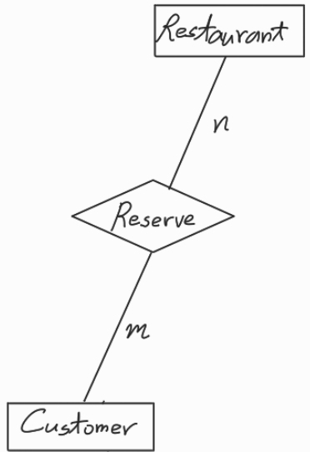
Relationships
From the specification
A customer can make a reservation for restaurants, which contains the estimated arrival time and the number of people whom he/she accompanies.
Reserve
Many customers can make reservations for many restaurants.
Many-to-Many

Slide 14
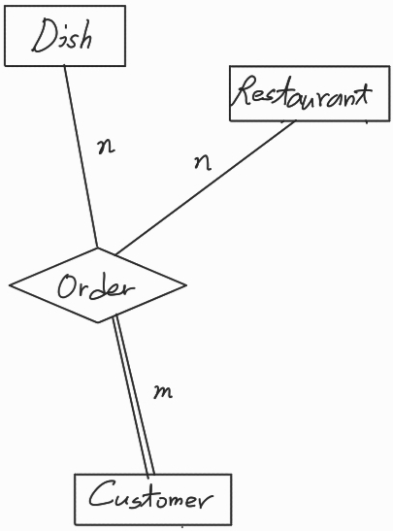
Relationships
From the specification
A customer may be able to order some dishes. The price of ordered dishes and the number of them are stored on the database. One type of dish can be requested by many people.
Order
Many customers can order the dishes from many restaurants.
Ternery

Slide 15
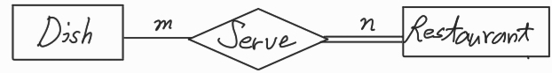
Relationships
From the specification
One restaurant is able to serve many dishes and another restaurant may have the same menu that the former one serves. Nevertheless, at least one dish should be served by each restaurant.
Serve
Many dishes can be served by many restaurants.
Many-to-Many

Slide 16
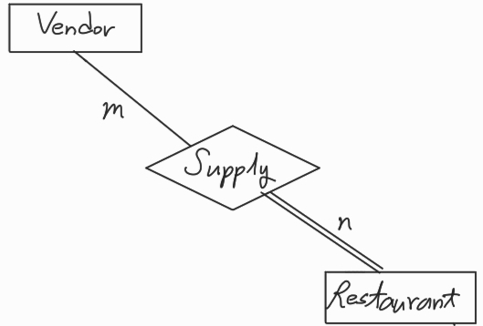
Relationships
From the specification
A vendor supplies ingredients such as vegetables and meats to the restaurants. Each restaurant can acquire some products from multiple vendors, and vendors can also supply them to a variety of restaurants. The ingredients which are given to the restaurant should be from at least one vendor.
Supply
Many vendors supply many ingredients to restaurants.
Many-to-Many

Slide 17
2
Tables & E-R Diagram

Slide 18
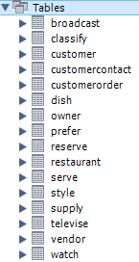
Tables
Summary
16 tables are created.
Each table may have constraints for data integrity.
Legend
Primary Key – as it is.
Foreign Key
Primary Key in that table – but comes from other tables.

Slide 19
Tables
Vendor (vendorCode, vendorName, ingredients, price)
Owner (RRN, ownerName, phoneNumber)
Restaurant ( restaurantCode, typeOfDishes, restaurantName, location, rating, phoneNumber, ownerRRN)
Supply(restaurantCode, vendorCode, suppliedDate, suppliedQuantities)
Dish (dishIdentifier, dishName, dishPrice)
Serve (restaurantCode, dishIdentifier)
Style (styleName, description)

Slide 20
Tables
Classify (styleName, description)
Customer (customerIdentifier, customerName, customerSex, customerAge, earnedPoint)
Prefer (customerIdentifier, styleName)
customerContact (customerIdentifier, phoneNumber)
customerOrder (customerIdentifier, restaurantCode, dishIdentifier, totalDishes)
Reserve (customerIdentifier, restaurantCode, reservedTime, numberOfPeople)

Slide 21
Tables
Broadcast (name, broadcastingCompany)
Televise (broadcastName, restaurantCode, televisedDate)
Watch (customerIdentifier, broadcastName)

Slide 22
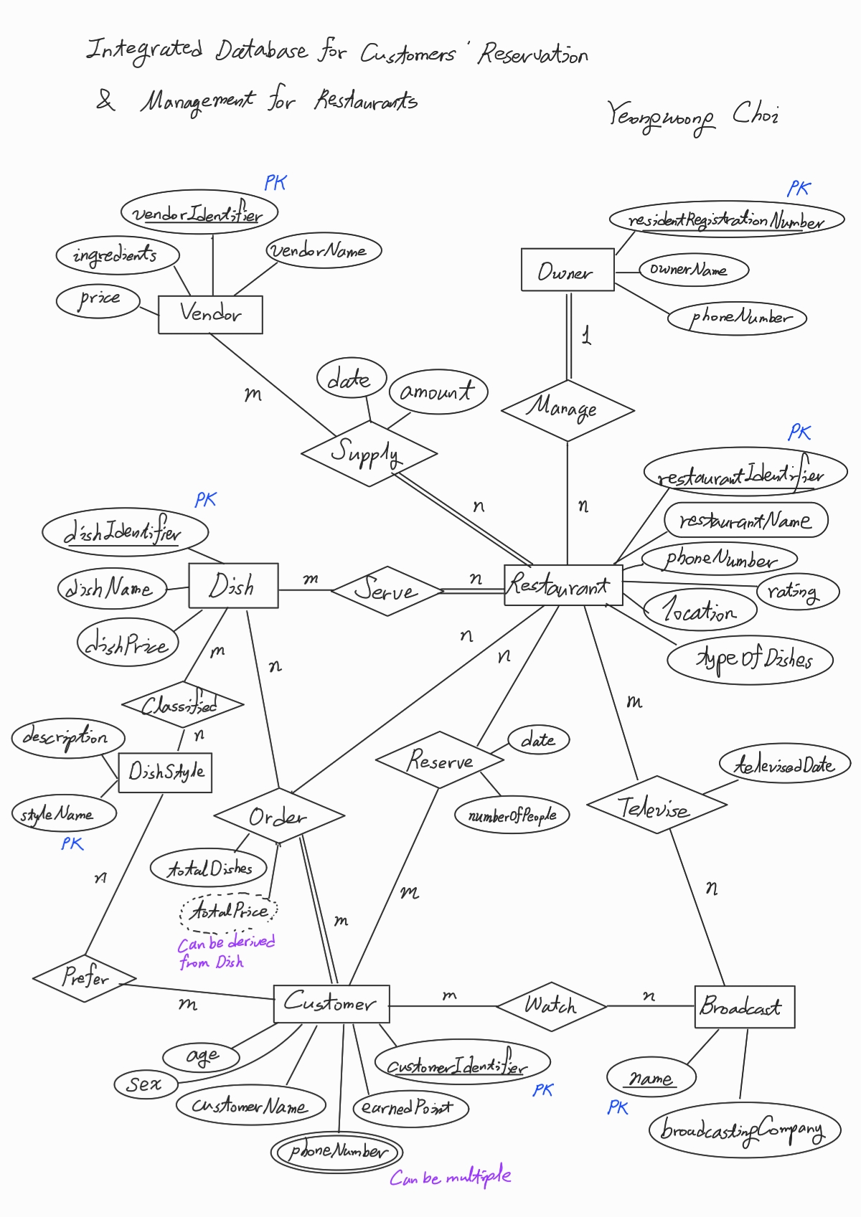
E-R Diagram

Slide 23
3
SQL Queries

Slide 24
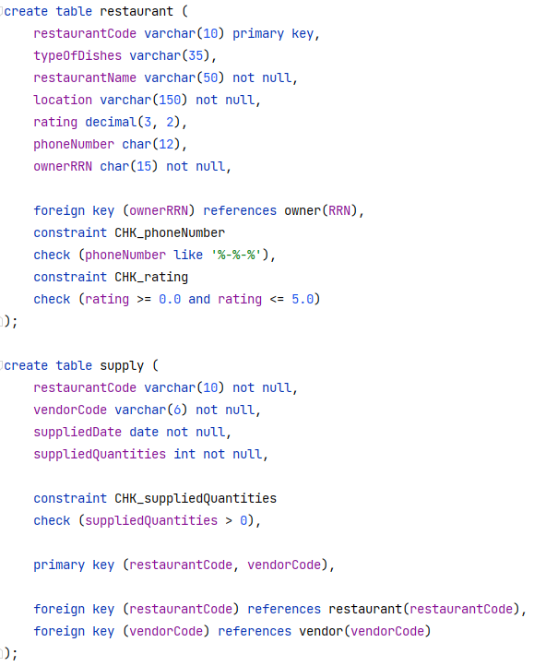
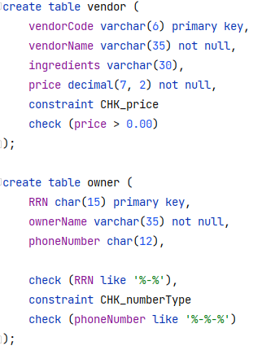
Part 3
Creating Tables

Slide 25
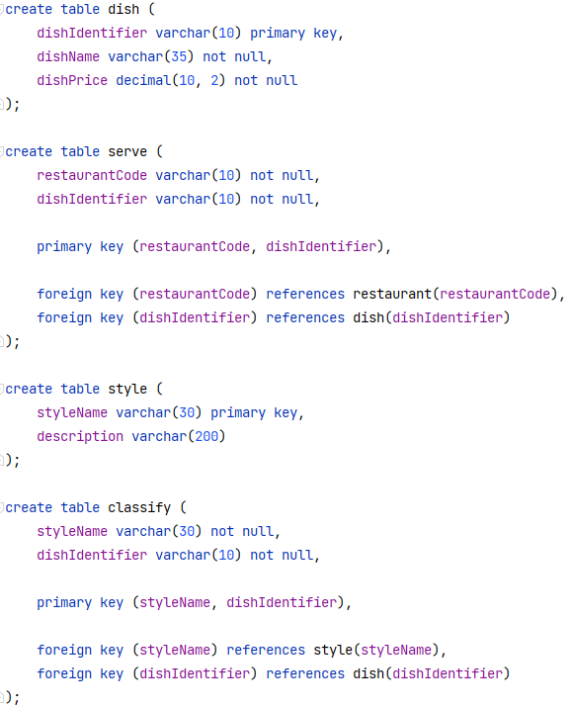
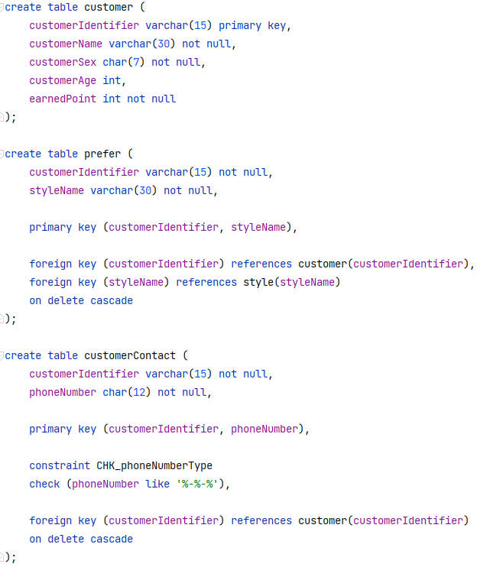
Part 3
Creating Tables

Slide 26
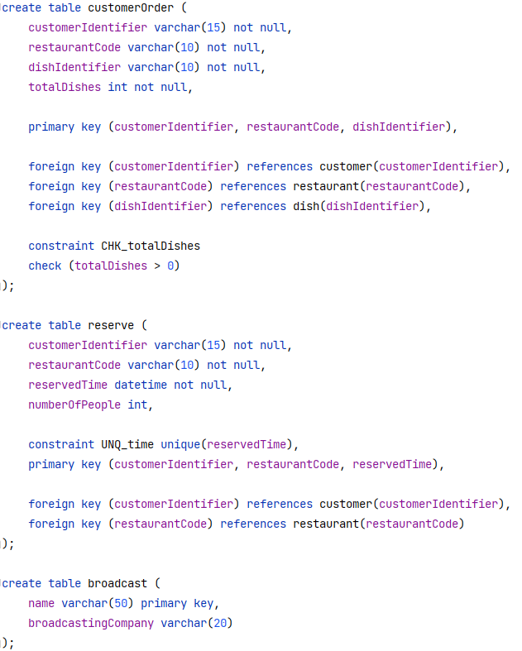
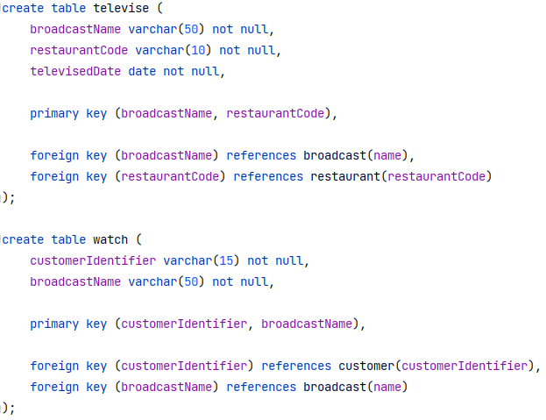
Part 3
Creating Tables

Slide 27
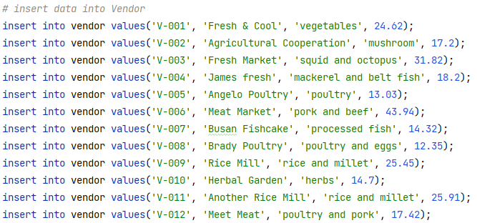
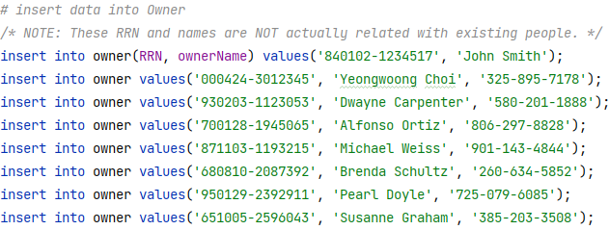
Part 3
Data Insertion

Slide 28
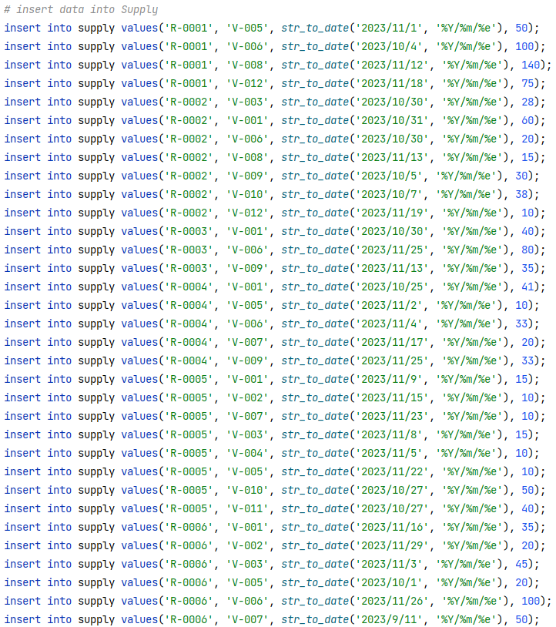
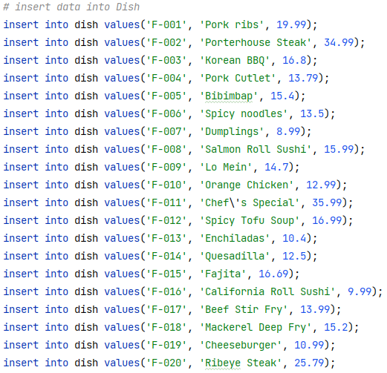
Part 3
Data Insertion

Slide 29
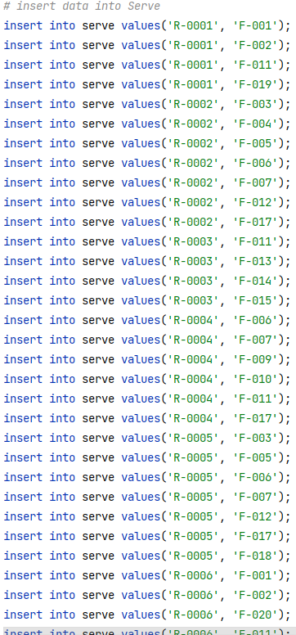
Part 3
Data Insertion

Slide 30
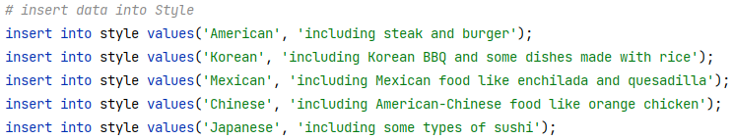
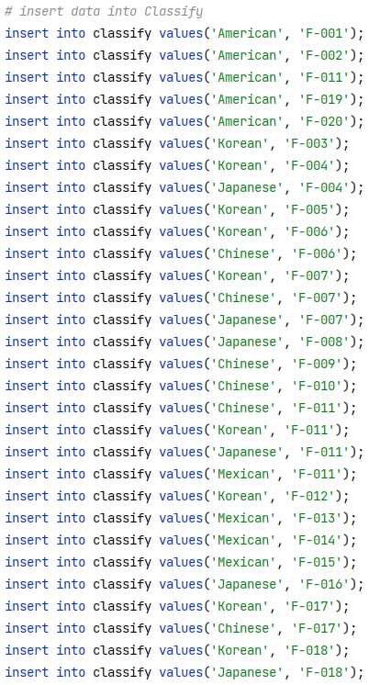
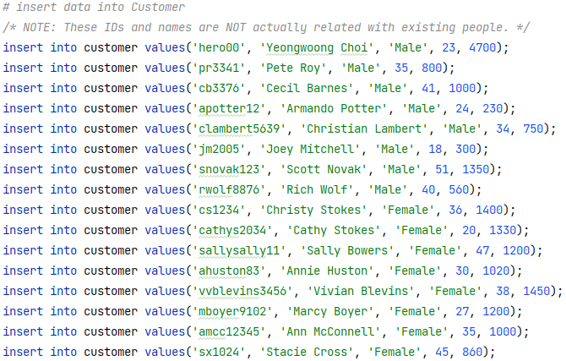
Part 3
Data Insertion

Slide 31
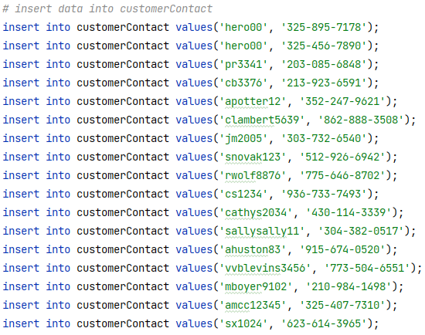
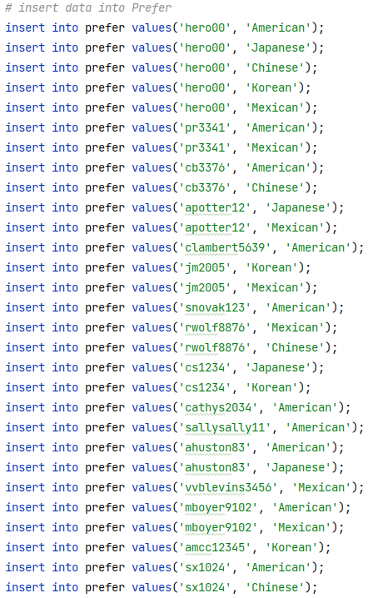
Part 3
Data Insertion

Slide 32
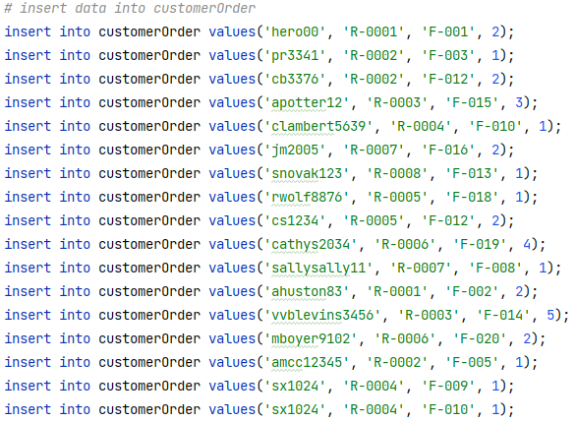
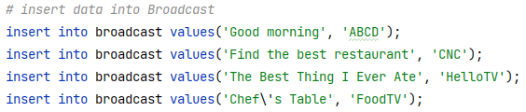
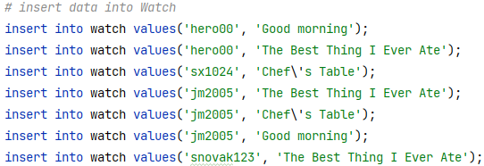
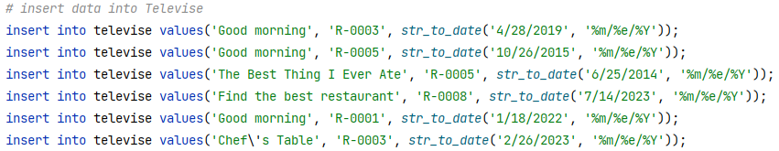
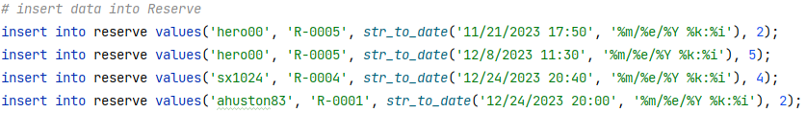
Part 3
Data Insertion

Slide 33
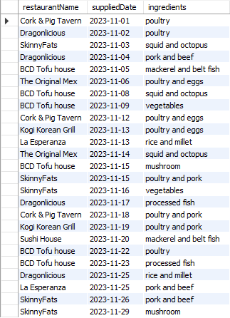
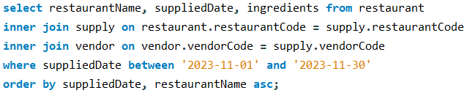
Part 3
Queries
Find the name of the restaurant, the supplied date, supplied items which are supplied to it in November 2023.
Results should be in the ascending order by the date. If they are same, sort according to the lexicographic order by the name of restaurants.

Slide 34
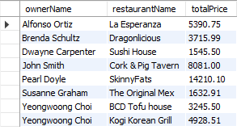
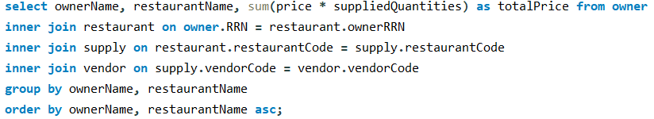
Part 3
Queries
Owners used to have curiosity about the cost of all ingredients that are supplied and used to cook.
Find the name of owners, restaurants and the sum of costs of the places which are managed by each one.
Results should be in the lexicographic order by the name of owners. If they are same, sort according to the order by the name of restaurants.

Slide 35
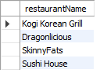
Part 3
Queries
Find the name of restaurants, which have not been televised.

Slide 36
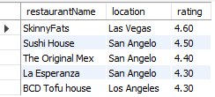
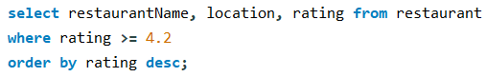
Part 3
Queries
Some people insist that real hotspots for foodies should be given at least 4.2-star rating. Find the restaurants for these people.
Results should be in the descending order by rating, and only contain the name, location and rating of them.

Slide 37
4
Demo Program

Slide 38
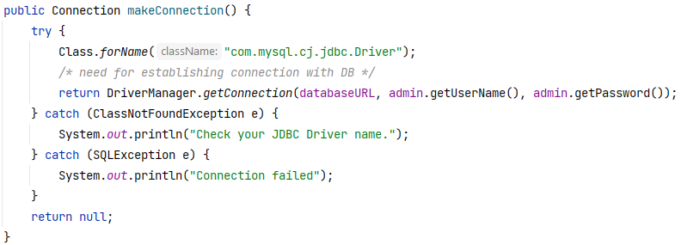
Part 4
Simple Program Using This Database
Customer can log on to the program.
Signing up may be needed to new customers.
They can search the restaurants by a keyword – type of dishes they serve.
They can make or cancel reservations that they already did.
Dependencies
JDBC Type 4 driver, MySQL Connector/J 8.0
MySQL 8.0.25+
Java 11+

Slide 39
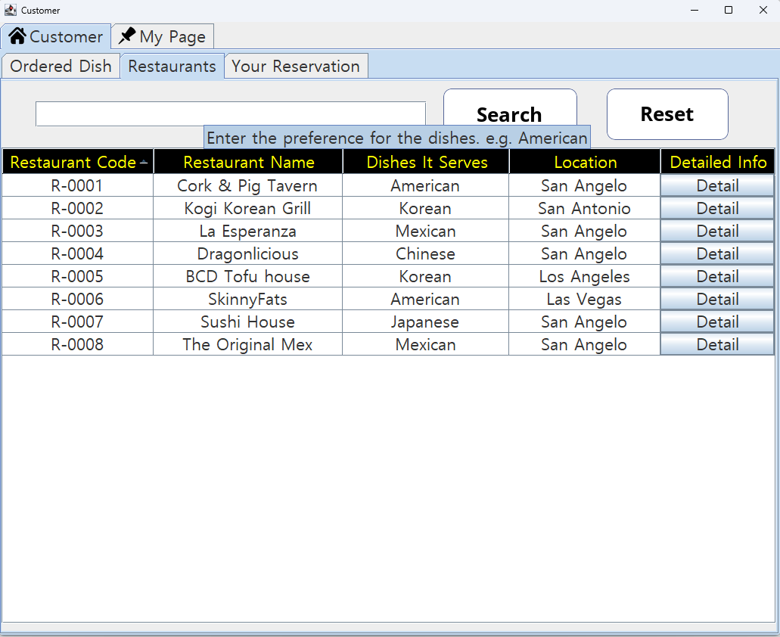
Part 4
Simple Program Using This Database
List all restaurants
If you click “Detail” button on each row, the information about the restaurant will be open at a new window.

Slide 40
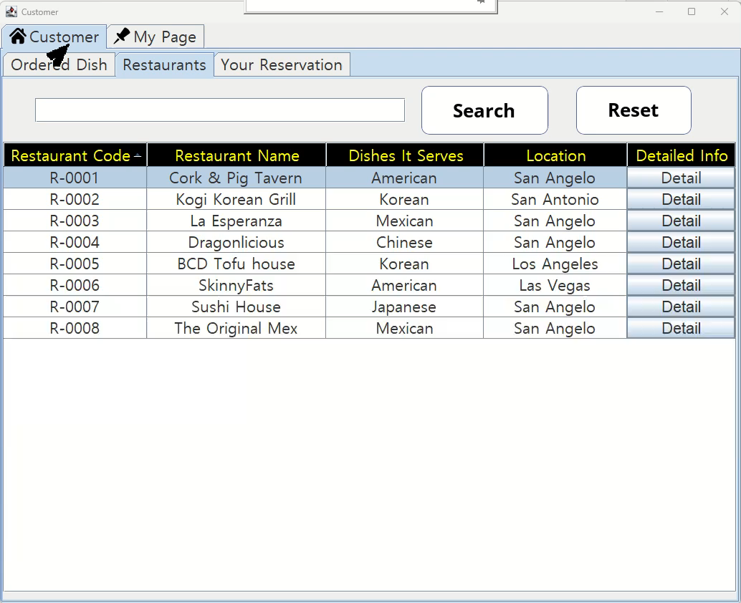
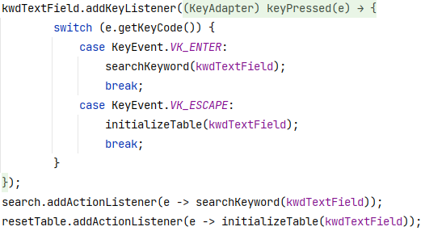
Part 4
Video
Keyword searching by the preference
If you enter “Enter” key or click a “Search” button, search results will print.
If you enter “Escape” key or click a “Reset” button, table will be initialized.

Slide 41
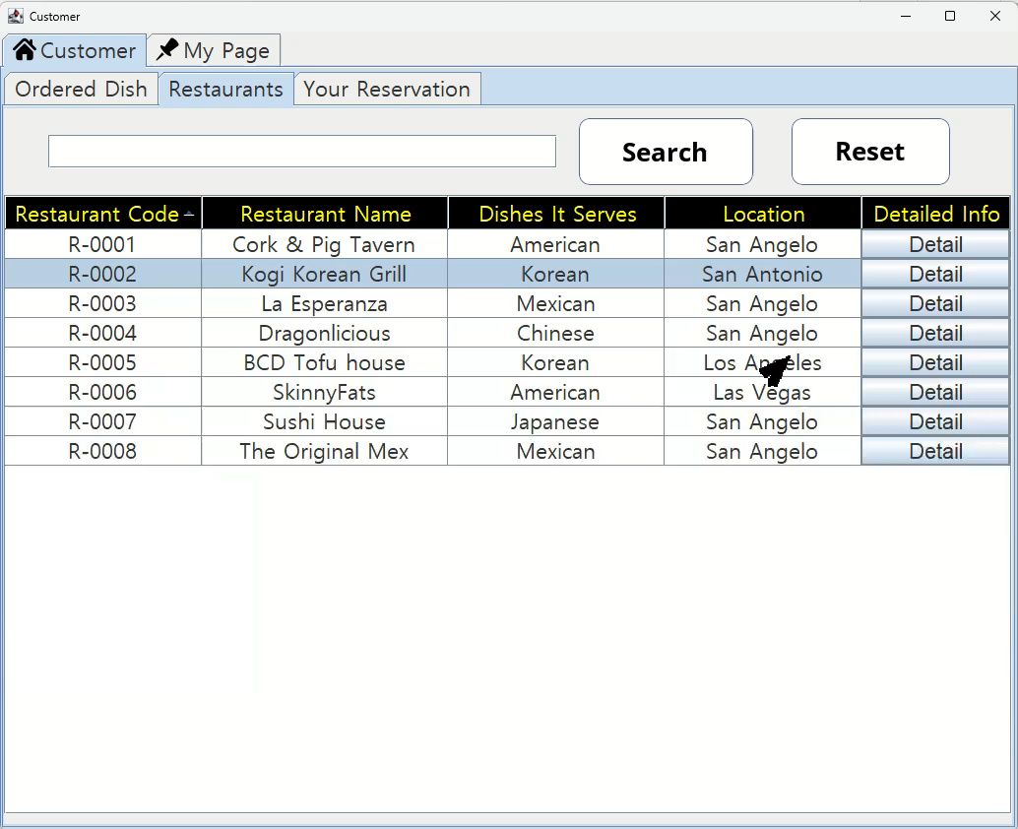
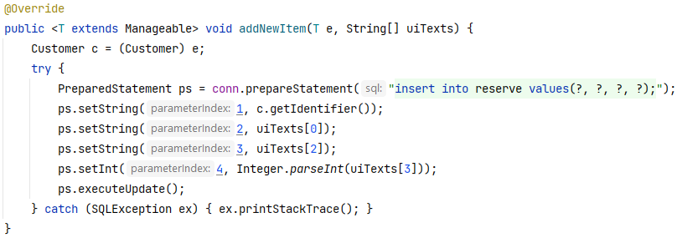
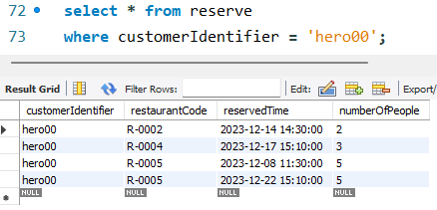
Part 4
Video (Reservation)
You can make a reservation for each restaurant.
After doing that, the information he/she made will be stored in the database.

Slide 42
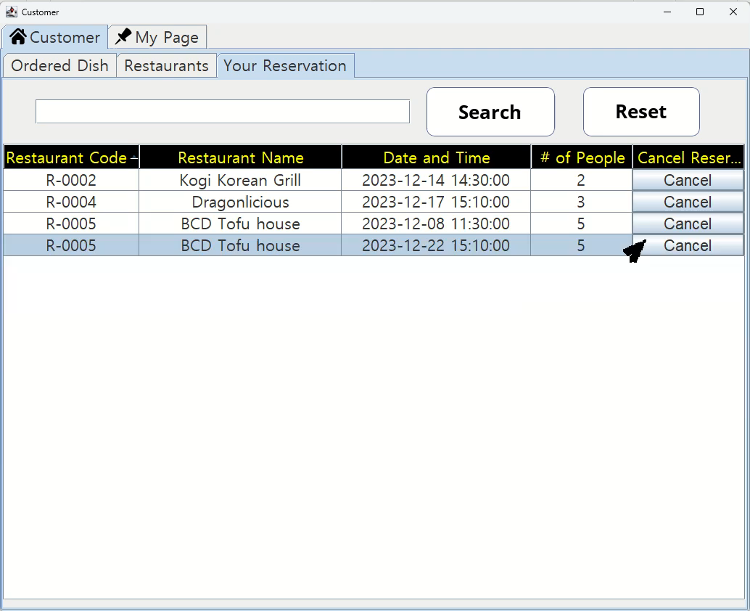
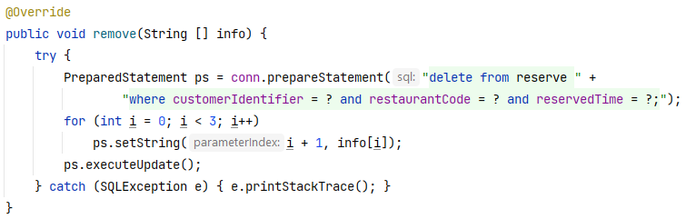
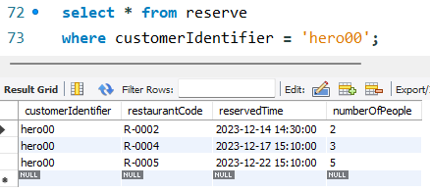
Part 4
Video (Cancellation)
You can cancel a reservation.
After doing that, it will be removed from the database.

